Slide 1
NEW SPR INITIATIVES
KYTC Statewide Planning
January 16, 2019

Slide 2
Agenda
Introduction
What are SPR Funds?
Ongoing Studies
Planning Guidance Manual
Truck Network Procedures
D4/D10 Connectivity Pilots
Call for Future SPR Studies
Planning Studies in the Six Year Plan

Slide 3
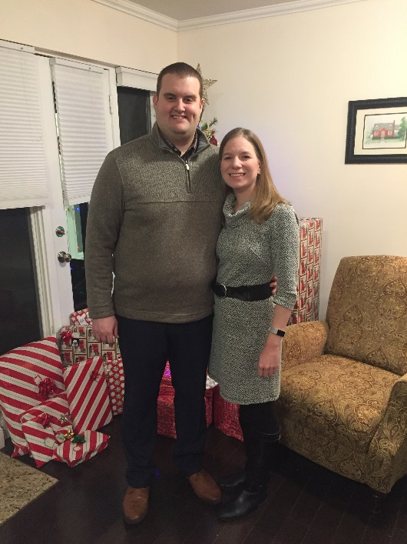
Introduction
Steve De Witte
Corridor Team Lead
2013 Purdue Graduate (BSCE)
Worked 5 years in consulting (CDM Smith)
2 years Medical Leave
Joined KYTC June 2018

Slide 4
What are SPR Funds?
Statewide Planning & Research
Mix of Federal Dollars and State Match
Work Program required by 23 CFR 420.111 each fiscal year*
MPOs and ADDs also receive funding via SPR
Strategic Planning generally has ~$1.2 million of SPR monies available for outsourcing each fiscal year.
KYTC Division of Planning SPR Usage
 | Federal | State Match | Total
Personnel Costs | $7,400,800 | $1,850,200 | $9,251,000
Outsourcing Costs | $2,056,000 | $514,000 | $2,570,000
Other Costs | $564,000 | $141,000 | $705,000
Total SPR Funds | $10,020,800 | $2,505,200 | $12,526,000
*Work Plan on KYTC Planning website
Notes:
Work plan is on KYTC CO Planning website
$1.2 million -> $2.4 million of combined $4.5 million SW Planning Contract upset limit

Slide 5
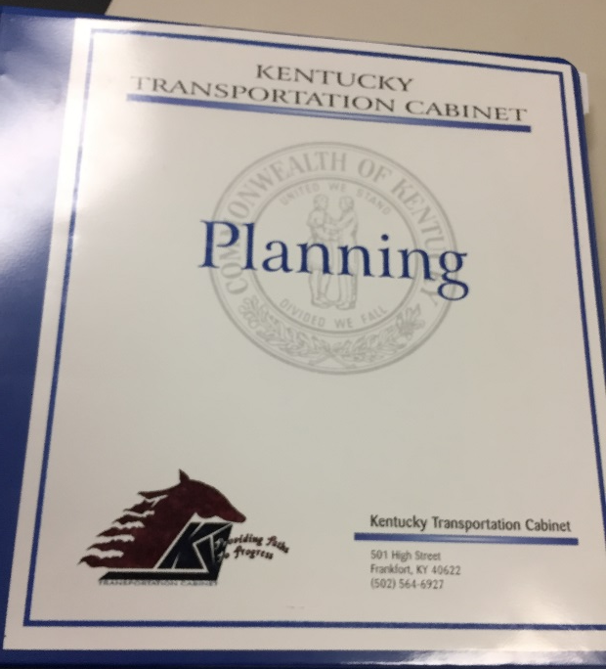
Planning Guidance Manual
Problem: No Official Updates Since 1991
Draft Updates ~ 2005, 2011
Never Finalized
Fast forward to today: Limited internal time/resources
Getting by on patchwork/ad-hoc guidance and institutional knowledge
Notes:
Hopefully whoever was in your position before wrote something useful down, or when you got a phone call you didn’t know what to do with.

Slide 6
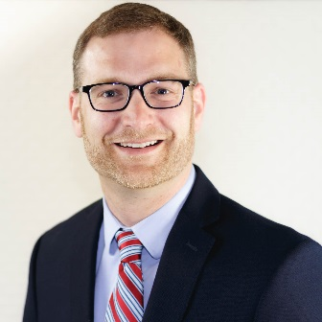
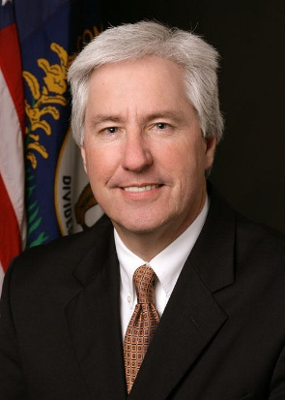
Planning Guidance Manual
Solution: Use SW Planning Contract and SPR Funds
12/6/2018: Assigned to HMB
Scope/Fee TBD
Organized by topic, not branch or district
Update at July STP Meeting
Completion November 2019
Notes:
What do we do about this? Use SW and SPR Funds
Topic based manual is subject of KHIT 124 Policy Guide with Jarrod Stanley working with KTC.

Slide 7
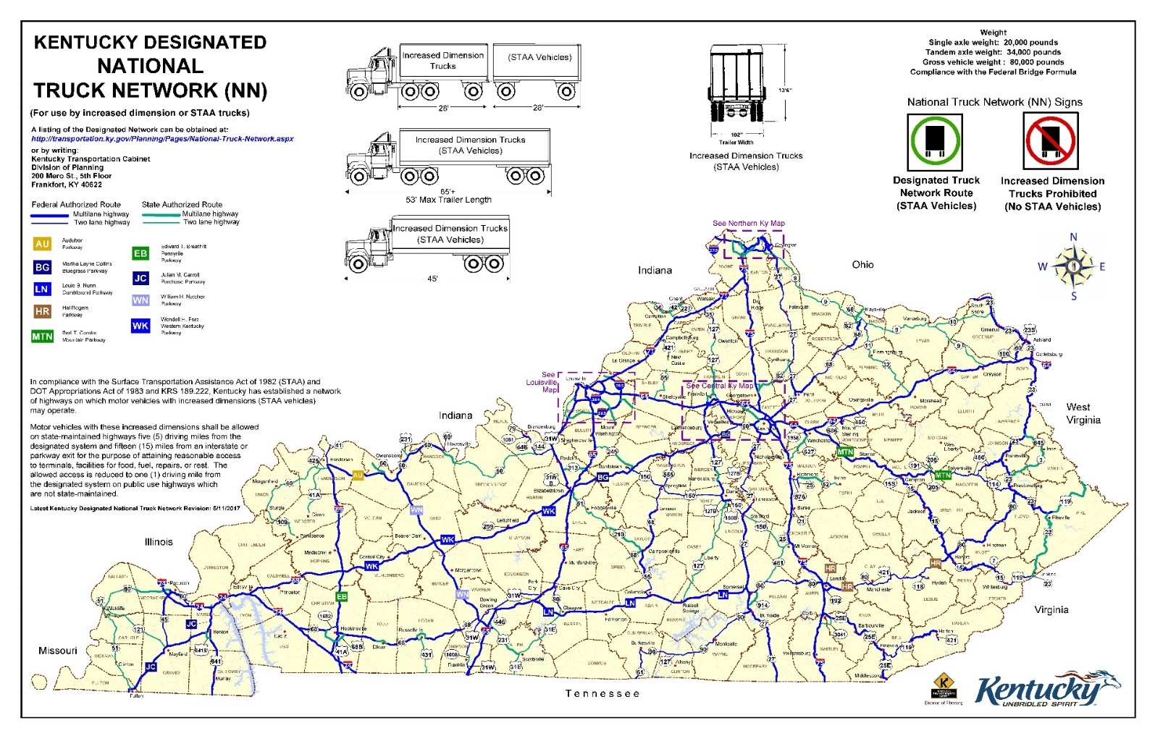
Truck Network Procedures Study

Slide 8
Truck Network Procedures Study
Goals:
Review existing state laws and regulations
Review policies and procedures of other states
Recommend a policy for adding/removing a route from the state network
Determine pertinent evaluation criteria and assess implications
Recommend a signage strategy
Notes:
Background: KY 151 lawsuit, emergency temporary deletion, lack of clear guidelines

Slide 9
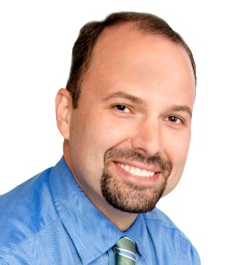
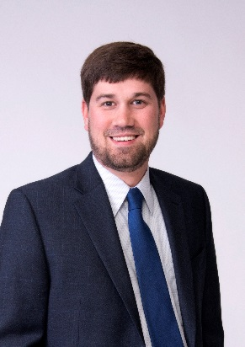
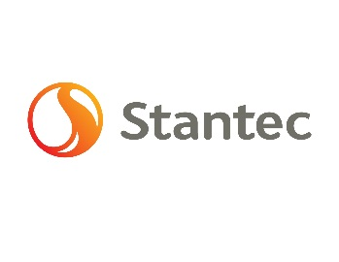
Truck Network Procedures Study
Using SW Planning Contract and SPR Funds
12/6/2018: Assigned to Stantec
Scope/Fee TBD
Preliminary Findings presentation at STP October 2019
Completion December 2019
Notes:
Stantec also consultant on KY 151 project in litigation

Slide 10
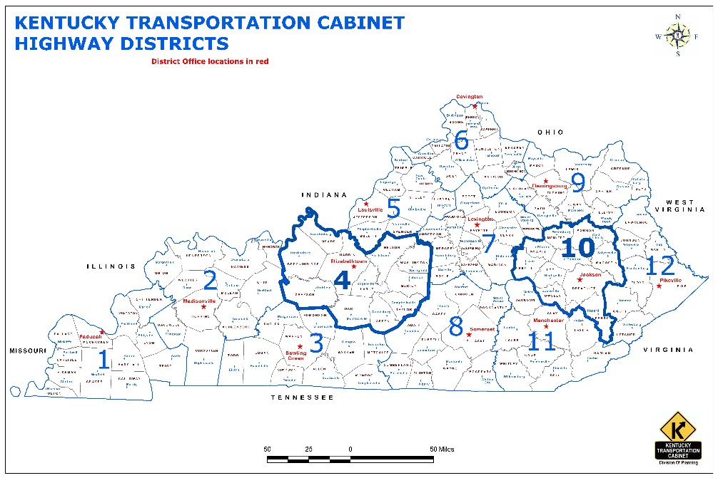
D4/D10 Connectivity Studies
Pilot Studies to Identify Connectivity and Accessibility
Studies running side-by-side
Identify impactful corridors for jobs, service (healthcare, food), and other needs
Identify needs due to future land use changes and growth
Identify short- and long-term priorities under different funding scenarios
Examine how many additional jobs are feasible to travel to after corridors are improved

Slide 11
D4/D10 Connectivity Studies
Next Steps:
Studies wrapping up over next few months, taking a little longer than expected
Draft Report from D10 expected imminently
Sit down with Districts and Consultant and discuss lessons learned
Make decision on if/when other Districts should be studied

Slide 12
Call for Future SPR Studies
Potential Studies due January 31
Provide as much information as possible
Will be scored using SHIFT metrics (as test run for SHIFT 2020)
Scopes of <$250,000
Prioritized high, medium, low
Will need to be in CHAF before scoring

Slide 13
Planning Studies in SYP
We’re here to help!
Studies $250,000 or Less
District choice to use the SW Planning on-call contract
Co-project managers from District and Central Office
I take care of all the invoicing!
Authorizations still go through Location Engineer, CC SPAC
Studies more than $250,000
District-led, CO can help manage or serve on Selection Committee
SPAC Liaison membership on Project Team
Authorizations still go through Location Engineer, CC SPAC
Notes:
Future electronic widget so that Planning can ask to authorize P phase funds using statewide.

Slide 14
Thank You!
Questions?
Stephen G. De Witte
Strategic Corridor Planning Team
KYTC Central Office – 5th Floor West
Stephen.DeWitte@ky.gov
(502) 782-5056

